Slide 1
ELECTROLUMINESCENCE
Presented by: Mir Masrur
Student ID: 2001019

Slide 2
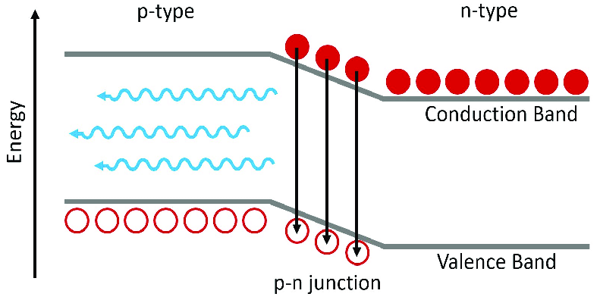
Introduction to Electroluminescence
Electroluminescence is the emission of light by materials due to an electric field or current.
It happens due to spontaneous emission (radiative recombination).
Commonly seen in LEDs, automobile dashboards, night lamps, etc.
Requires semiconducting materials, usually with a p-n junction.

Slide 3
Historical Development
1752: Benjamin Franklin observed lightning as electric discharge.
1907: H.J. Round observed EL in SiC.
1923: O.V. Lossev reported EL in SiC crystals.
1936: Georges Destriau published findings on ZnS electroluminescence.
1950s-70s: Emergence of EL displays by GTE, IBM, Rockwell, etc.

Slide 4
Mechanisms of Electroluminescence
Pure/Intrinsic Mechanism
2. Charge Injection Mechanism

Slide 5
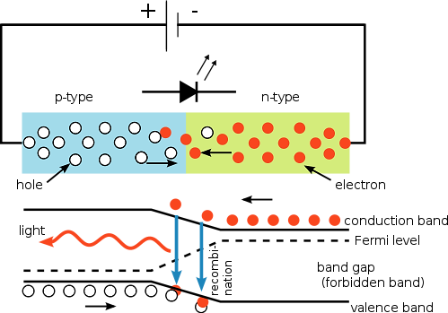
Pure/Intrinsic Mechanism
The total current which passes through the electroluminescent material is zero.
In this case, electrons of the atom are liberated in the conduction band through thermal activation energy and electric field.
Figure 2. Pure or intrinsic mechanism.

Slide 7
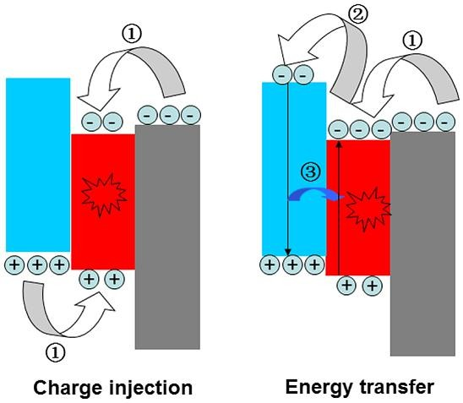
Charge Injection Mechanism
In this process requires a p-n junction.
Current flow enables recombination of electrons and holes, emitting light.
Figure 3. Charge injection mechanism.

Slide 9
Origin of Light Emission
Electrons (–) and holes (+) recombine to emit light when electrons are excited to higher energy levels within the crystal.
The emitted light corresponds to the energy difference, E=hν. Recombination occurs at specific centers called recombination sites.
The emission is localized within certain regions of the material, as seen in Cu-doped ZnS, which shows high light yield.

Slide 10
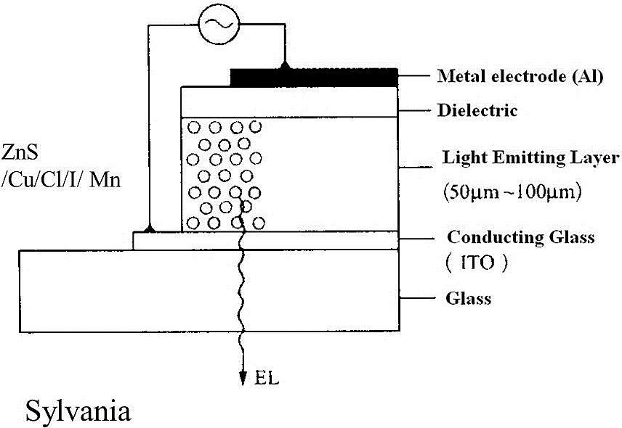
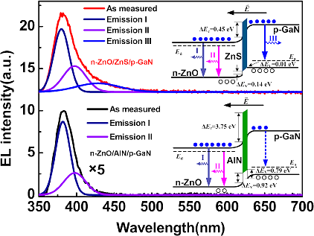
Figure 4. EL structure of ZnS.
Figure 5. . EL emission spectra of Zns and AlN.

Slide 11
References
Shukla, Usha. (2024). Electroluminescence. 11. 2021.
Wilson, J., & Hawkes, J. F. B. (1998). Optoelectronics: An Introduction (3rd ed., p. 138, Section 4.5). Prentice Hall.
Additional sources from Britannica, ScienceDirect, IEEE.

